Slide 1
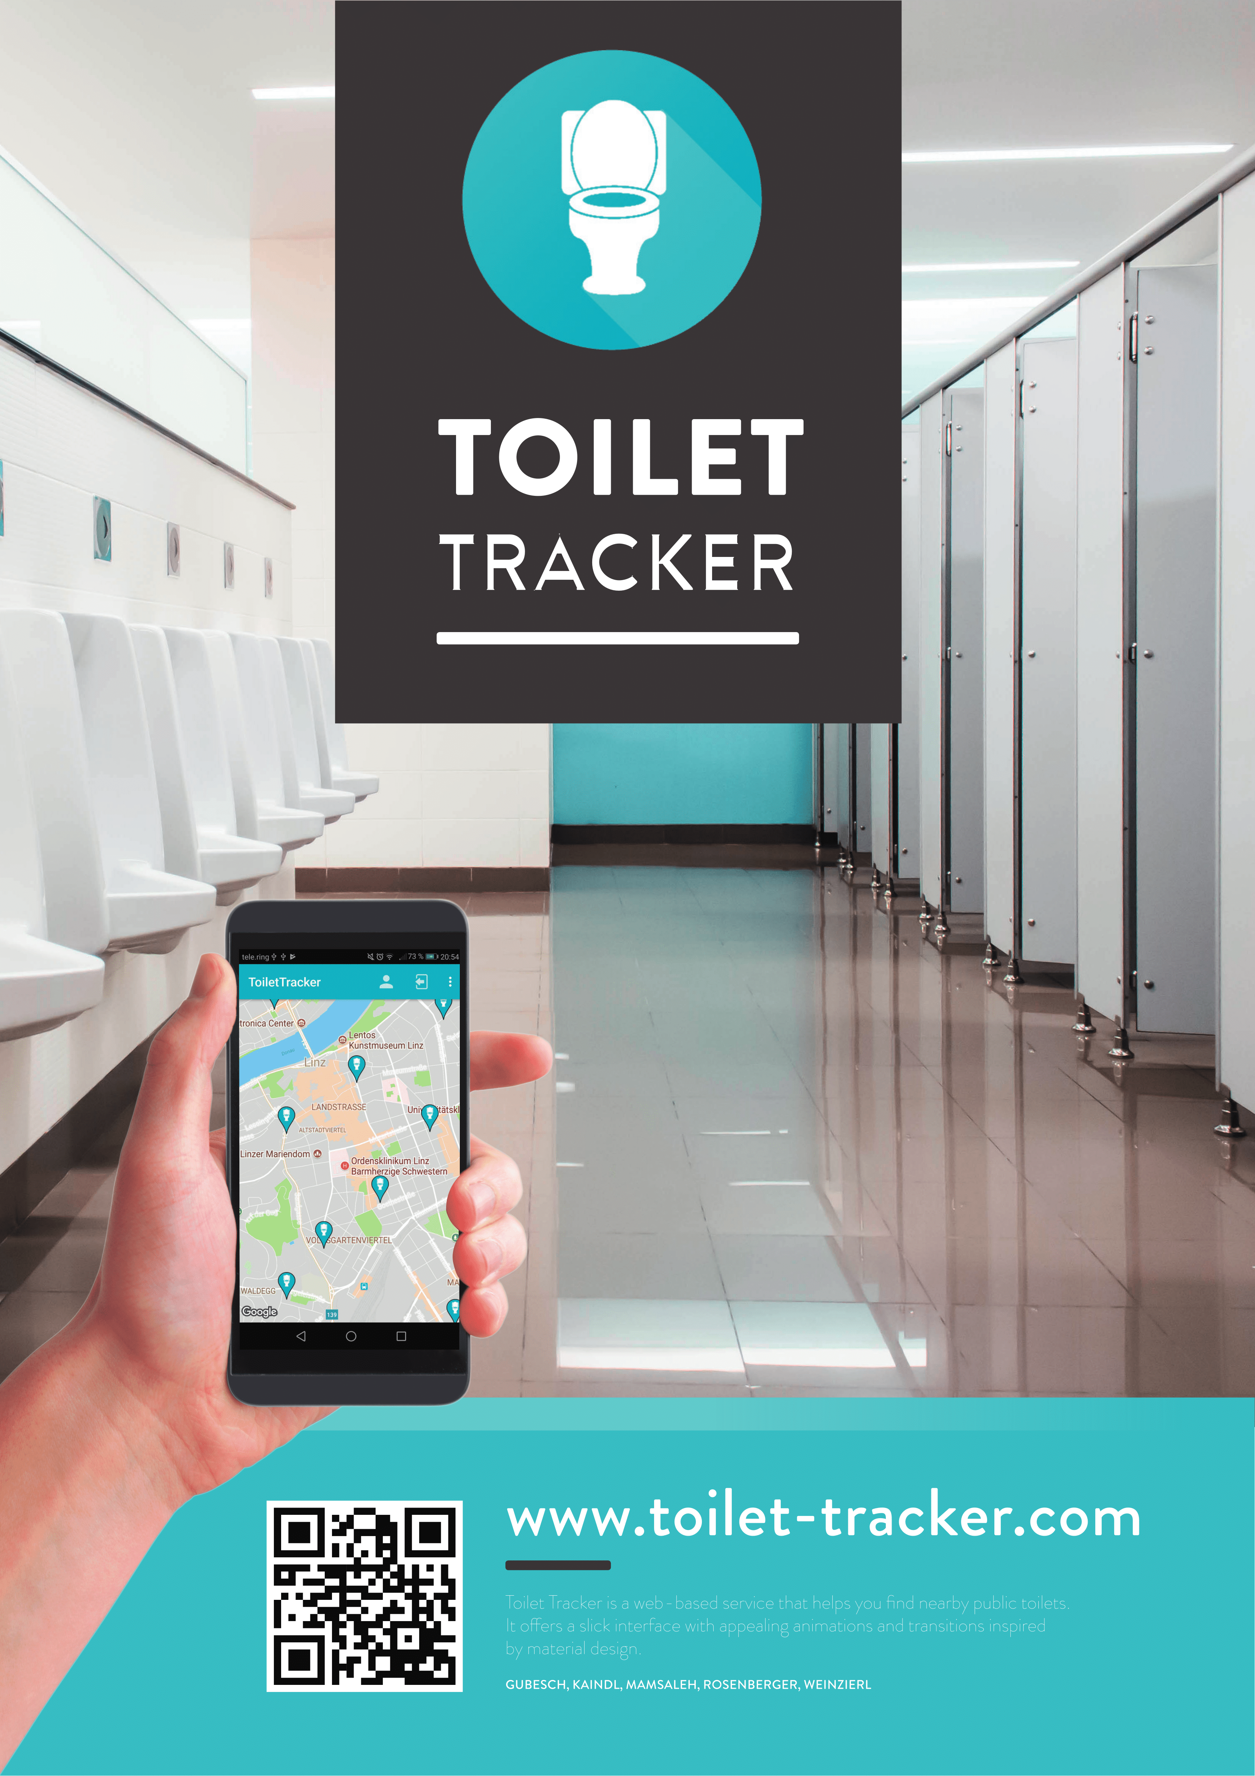

Slide 2

Gliederung
01
Team
02
Timeline
03
Toilet Tracker
04
Demo

Slide 3


Team

Slide 4





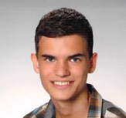
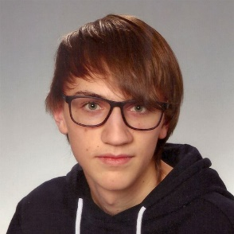

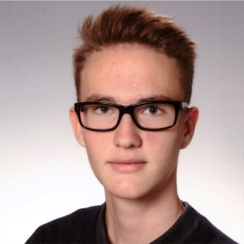
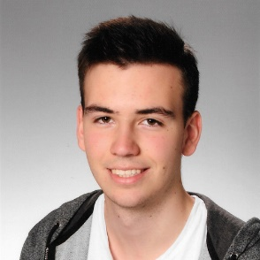
Our Team
Gubesch
Kaindl
Mamsaleh
Rosenberger
Weinzierl
Testing
Documents
Web Client
Database
Documents
Mobile Client
Documents
Projektleiter
Documents
API
Documents
Content

Slide 5
Timeline

Slide 6


Time Line
First Sprint
Second Sprint
First Release
Project Proposal
System Specification
8. Oktober
2017
24. Dezember
2017
22. Jänner
2018
5. März
2018
9. April 2018

Slide 7
Time Line
Second Release
Third Sprint
14. Mai
2018
11. Juni 2018

Slide 8
Toilet Tracker

Slide 9





Toilet Tracker
Global Usability
Filter Toilets
You can use our App every- where you want!
You can use our filter function to filter Toilets!
Rate Toilets
Tell us what you liked about the place!
Toilet
Tracker
Easy to Use
Simple user interface.

Slide 10
Demo

